Slide 1
GNOSIS Guide
Navigating GNOSIS for Obstetrics
2014

Slide 2
Table of Contents
1
Evolution & Mission of APS
6
GNOSIS Learning Path
2
What is GNOSIS?
b
Overview of the Learning Path
3
Responsibilities of a GNOSIS Peer Mentor
c
Beginning the Learning Path
Training Learning Objectives
d
Average GNOSIS Completion Times
4
Beginning GNOSIS: Personal Proficiency Module
7
GNOSIS Certificates
5
a
Certificates for earned CME/CE Credits
a
Knowledge Questions
Certificates
Judgment Questions
b
Memorandum of Completions
b
Understanding the Likert Scale
c
Certificates vs.
Memorandum of Completion
c
d
Scoring
d
Accruing CME/CE Credits
d
PPM Structure & Time Allocation

Slide 3
Contents
8
GNOSIS Reporting for Clinical Users
10
The GNOSIS Peer Mentor Experience
a
Knowledge Report
a
Peer Mentor Reporting Dashboard
b
Judgment Report
b
Analyzing Practitioner Proficiency
c
Explain My Score Feature
1
Group Scores
9
GNOSIS Catalog
2
Knowledge PPM Scores
a
Courses with PPM
3
Judgement PPM Scores
b
Courses without PPM
c
Registrations
c
Dashboard with earned CME/CE credits
d
Course Status
e
Learning Path Status
f
Course Status v. Learning Path Status

Slide 4

Contents
11
Logging out of GNOSIS
12
Support and Additional Features
c
APS Customer Support
d
Profile & Settings
e
Contact Us

Slide 5
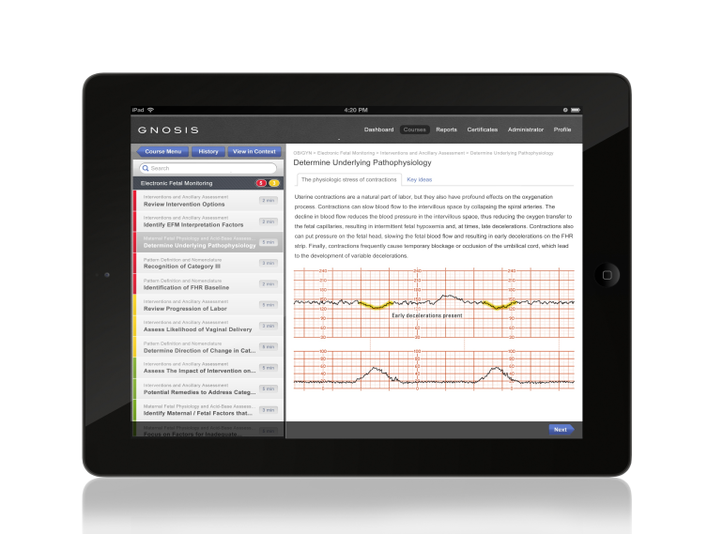
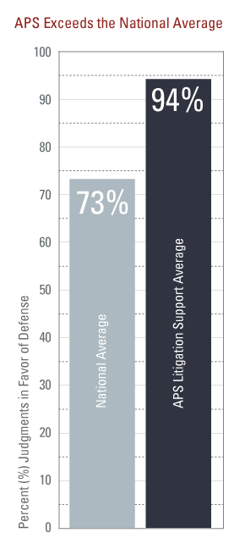
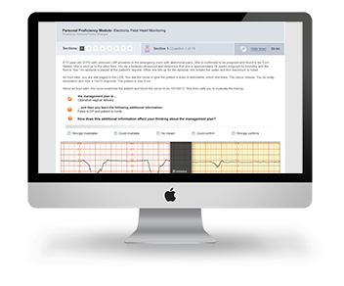
The Evolution of GNOSIS
GNOSIS
Prospective view of risk
Increase adoption
Improve judgment
APS eLearning Risk Management Patient Safety
Medical Illustrations
Avoid Error and Indemnity
Protect CRICO
Improve win rate
1993
2004
2012
1993
2004
2012

Slide 6
OUR MISSION We optimize healthcare outcomes by measuring and improving clinical decision-making.

Slide 7
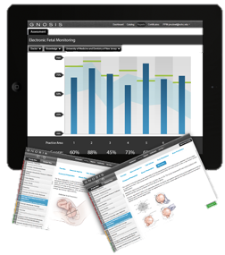
Introducing GNOSIS A New Approach to Patient Safety and Practitioner Excellence
GNOSISTM is a groundbreaking tool that delivers highly customized clinical education 3-8 minutes at a time
GNOSIS is a personal coach that will assess clinician’s learning needs, optimize learning time, and will rapidly improve clinician’s proficiency where they need it most
GNOSIS is designed to equip dedicated doctors and nurses to unleash great medicine
A Personal Coach
Assess clinical knowledge and judgment
Identify areas of strength and for improvement
Create a personalized learning path
Notes:
Gnosis is the next generation of tools for continuing and refreshing medical education.
Think of it as the clinician’s path to focused and personalized learning.
Gnosis will give you/your clinical teams a new perspective into how you can isolate your strengths and boost those areas that may need reinforcement.

Slide 8
Overview: How GNOSIS™ Works

Slide 9
Responsibilities of a GNOSIS Peer Mentor
Resources for GNOSIS Peer Mentors
If you need assistance navigating GNOSIS, understanding GNOSIS reporting, please contact your APS Client Services Manager.
Abby Panozzo
Manager, Client Services
apanozzo@aps-web.com
617.275.7253
1
Act as the primary internal champion for GNOSIS
2
Encourage participation and engagement with GNOSIS
3
Monitor the initial registration and engagement with GNOSIS
4
Ensure completion of GNOSIS coursework based on the guidelines provided by your organization

Slide 10
GNOSIS™ TRAINING LEARNING OBJECTIVES

Slide 11
GNOSIS™ Training Learning Objectives
1
Launch GNOSIS
2
Navigate to the Personal Proficiency Module and your Learning Path
3
Interpret your individual PPM score
4
Monitor coursework completion in GNOSIS
5
Access your accrued CME/CE credits
6
Access your Memo of GNOSIS™ Learning Path Completion

Slide 12




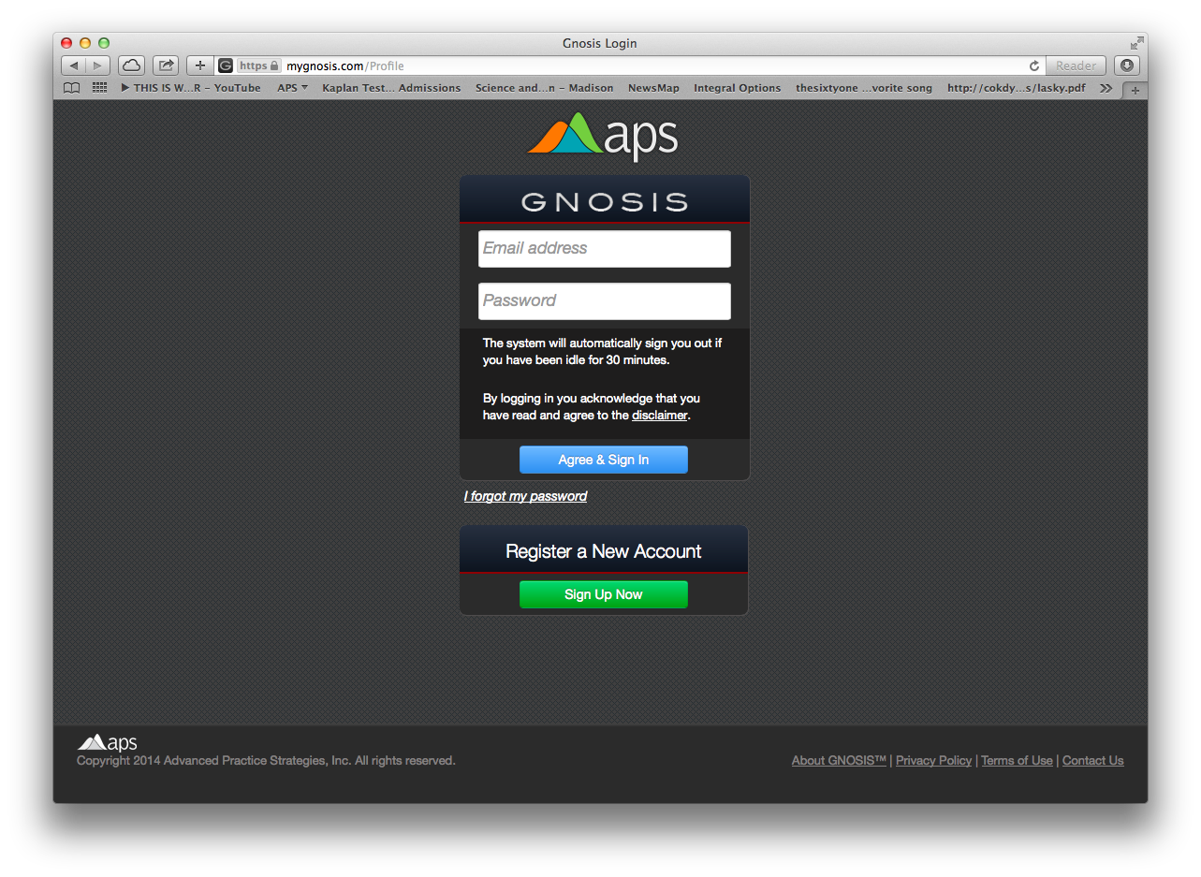
Getting Started with GNOSIS Logging into GNOSIS after Registration
How to Login to GNOSIS as an Existing User
Launch a web browser
Type mygnosis.com in the URL
Type the email and password you registered with GNOSIS
Select blue ‘Agree & Sign In’
1
2
3
4
Notes:
NOTE: users MUST select Groups
Users can still be moved around through groups after they have registered
Ascension/APS will do QA of groups = requires Ascension to have lists of users at each facility

Slide 13
BEGINNING GNOSIS THE PERSONAL PROFICIENCY MODULE

Slide 14
The Personal Proficiency Module
1
Assesses clinician’s strengths and areas to review
2
Answers from the PPM generates your personalized, prioritized Learning Path
3
Contains two question types: 1. Knowledge & 2. Judgment
4
Capture a clinician’s knowledge with simulated time-bound activity

Slide 15
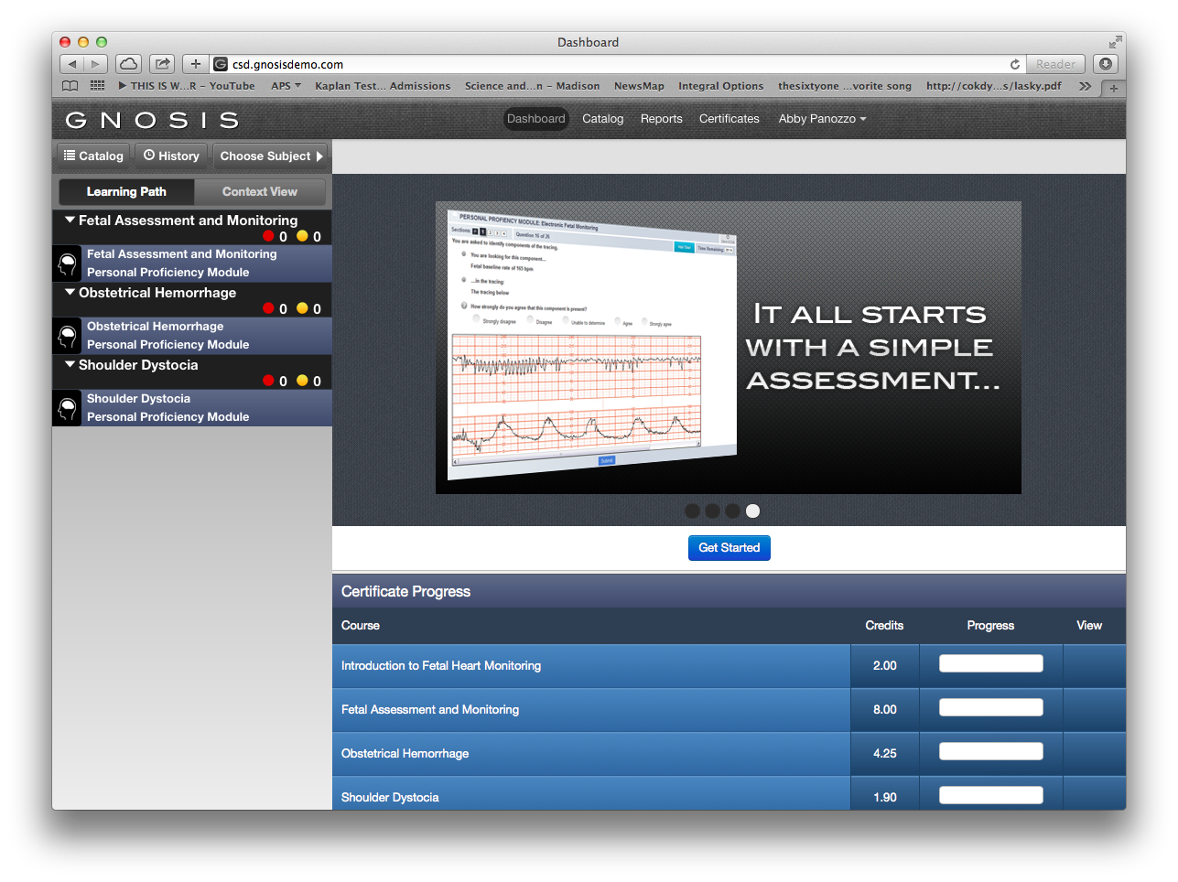
The Personal Proficiency Module
Beginning with a PPM provides a Learning Path with only content you need to review, saving you time
Select the purple band of the PPM subject area you want to begin
PPMs are offered for Fetal Assessment & Monitoring, Obstetrical Hemorrhage, and Shoulder Dystocia
1

Slide 16
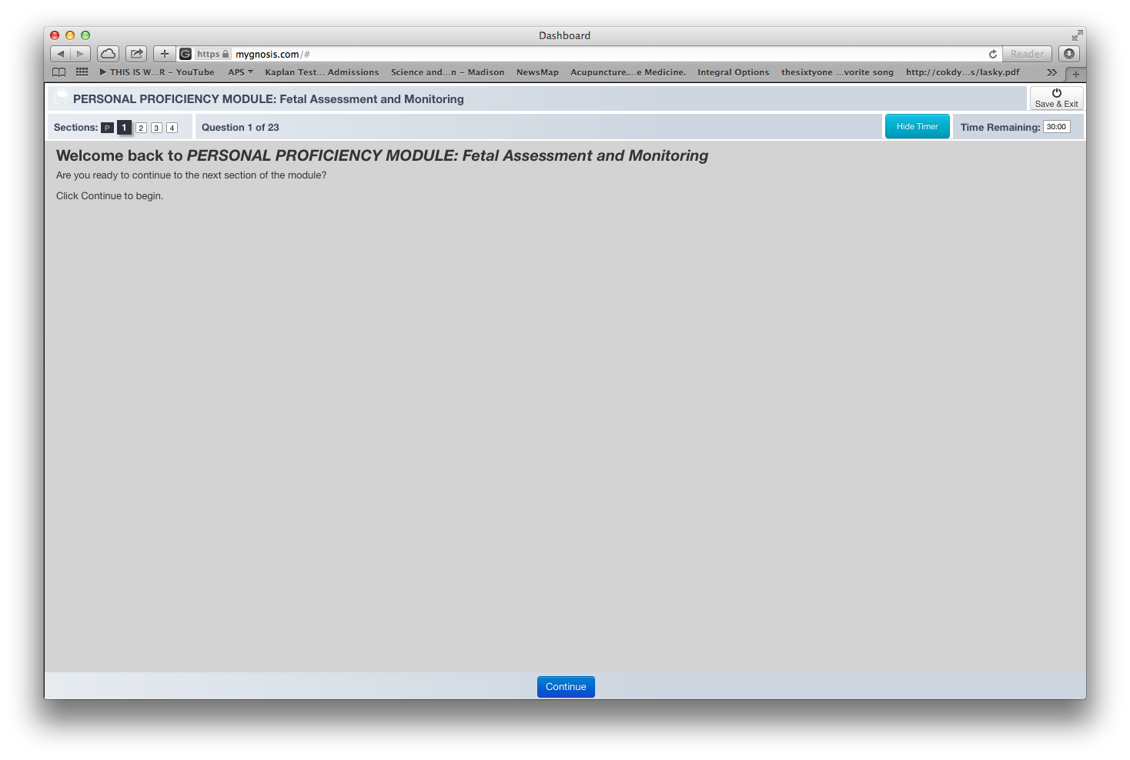
The Personal Proficiency Module
1
2
Each subject area PPM has a different number of sections.
You can click ‘Save & Exit’ only at the end of a PPM section
You can click ‘Hide Timer’ as an option
Click ‘Continue’ when you are ready to begin
3
4

Slide 17
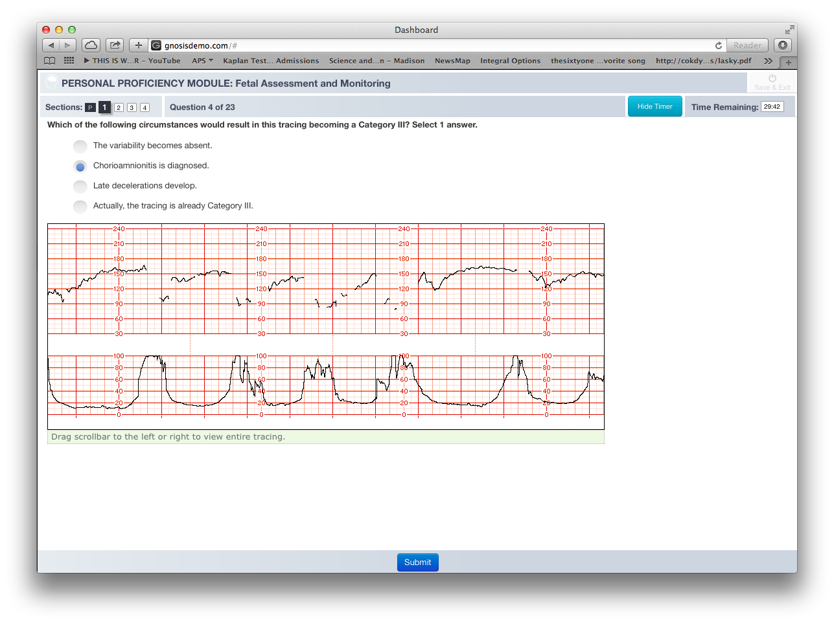
The Personal Proficiency Module Knowledge Questions
Knowledge questions assess base knowledge in each clinical Practice Area.
These questions often include a fetal monitoring strip, clinical scenario or both.
1.Read the question
2.Scroll to review Fetal Heart Rate tracing
3. Select appropriate response
4.Submit
1
3
2
Helpful tip:
Remember to scroll
4

Slide 18
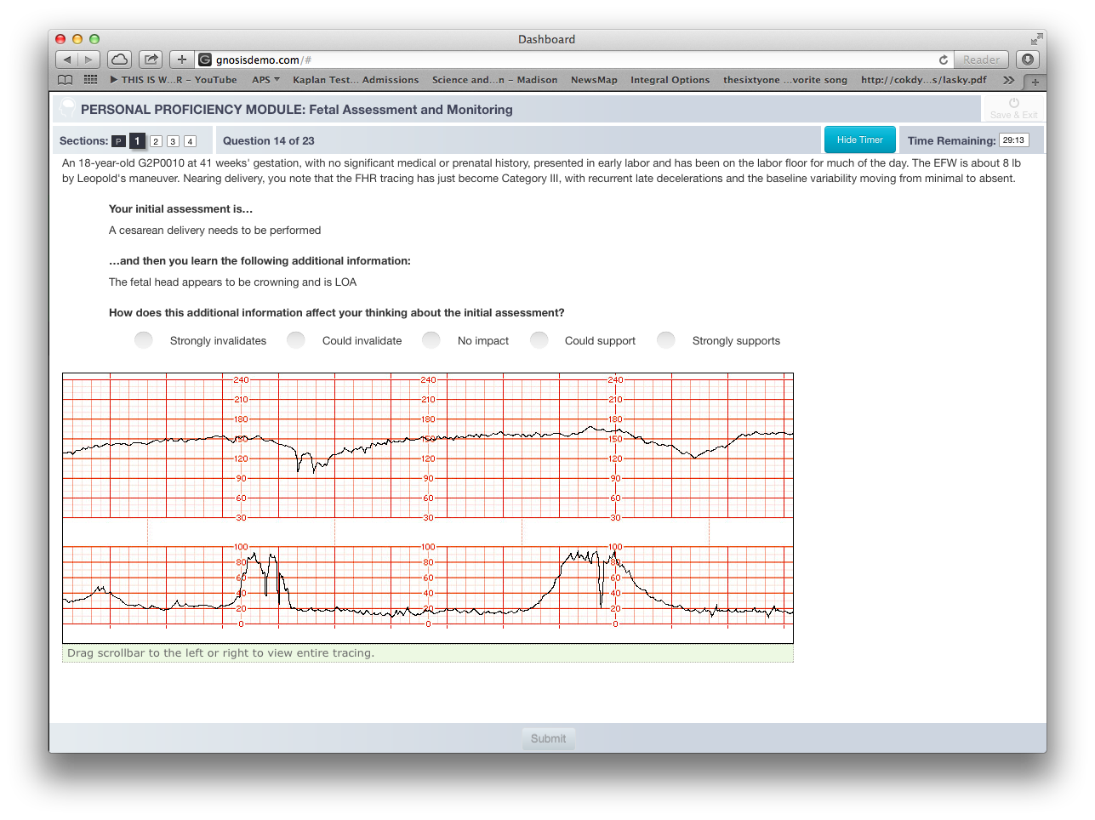
The Personal Proficiency Module Judgment Questions
Judgment questions assess the organization and application of knowledge to clinical scenarios.
These types of questions help to distinguish an individual’s ability to connect all the pieces of relevant information and reach a decision.
Background
Provided management plan
New Piece of Information
Submit answer
1
2
3
4
Helpful tip:
Remember to scroll

Slide 19
The Personal Proficiency Module Answering Judgment Questions using the Likert Scale
Answering judgment questions using a Likert scale is novel to many clinicians. An effective approach to choosing a response is to think about how this new information (often an Electronic Fetal Monitoring strip) might affect the assessment or management plan provided in the initial question.
Strongly Invalidates
Could Invalidate
No Impact
Could Support
Strongly Supports
You feel certain that the new piece of information should change the initial management plan or assessment. | You are leaning towards changing the initial management plan or assessment provided, but there are variables within the context of the case that give you pause. | This new information does not change your initial management plan or assessment, as it does not inform the original decision. | You are leaning towards continuing the initial management plan or assessment provided, but there are variables within the context of the case that give you pause. | You feel certain that the new piece of information reinforces the initial management plan or assessment provided.

Slide 20
The Personal Proficiency Module Scoring
Example: If a question is given to a panel of 10 experts and 6 of the experts respond to the judgment question as “could invalidate, then these 6 experts become the majority. If you respond to the question as “could invalidate”, then you earn 100% of the credit. The remaining 4 experts also respond as “strongly invalidates”. The majority (6 experts) becomes the denominator. If you align with the 4 experts you earn 66% of the credit.
Scoring of the PPM is different based on the type of question, knowledge or judgment
Knowledge Questions have a clear, correct answer, and are scored traditionally. Users do not receive credit for an incorrect answer and receive full credit for each correct answer.
Judgement Questions provide an opportunity to earn partial or full credit for aligning with subject matter expert’s¹ modal response
Strongly Invalidate
Could Invalidate
No Impact
Could Support
Strongly Supports
4 Experts
4/6 = 66%
6 Experts
6/6 = 100%
0 Experts
0/6 = 0%
0 Experts
0/6 = 0%
0 Experts
0/6 = 0%
1. Advanced Practice Strategies (APS) partners with a panel of Nurse and Physician medical experts who are selected based on their healthcare experience and academic profiles and are: nationally or regionally recognized, OB generalists and MFMs with 10+ years of experience, from academic medical centers and high-volume community practices, contributors to academic or clinical literature, located in different geographic regions

Slide 21
The Personal Proficiency Module Structure & Time Allocation
Subject Area PPM | Question Type in PPM | Number of Sections | Time Allocated to Complete PPM
Fetal Assessment & Monitoring | Knowledge & Judgment | 4 | 2 Hours
Obstetrical Hemorrhage | Knowledge & Judgment | 2 | Minutes
Shoulder Dystocia | Knowledge | 2 | 50 minutes

Slide 22
GNOSIS LEARNING PATH

Slide 23
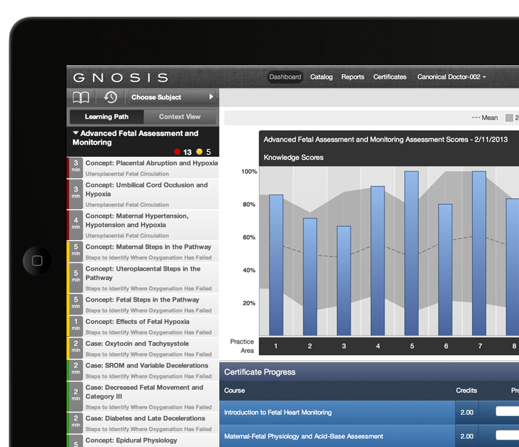
GNOSIS Learning Path
The learning path presents relevant course material, prioritized for each clinician’s personal needs. The items on the learning path are arranged by clinical significance and an individual’s answers to the assessment questions. Areas of greater potential clinical impact, or opportunities to improve knowledge or judgment, appear higher. Areas of lower risk impact, and those that the user already understands well, appear lower.
1
The Learning Path color represents the priority of content
Red represents high priority content, yellow represents medium, and green represents low
1
As content is completed it will move to the bottom of the Learning Path and become gray

Slide 24
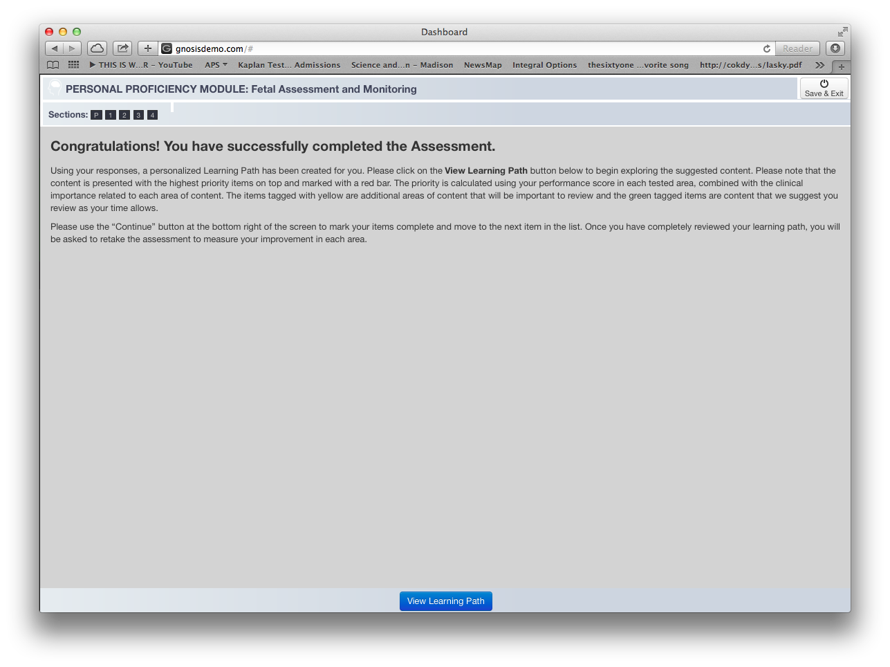
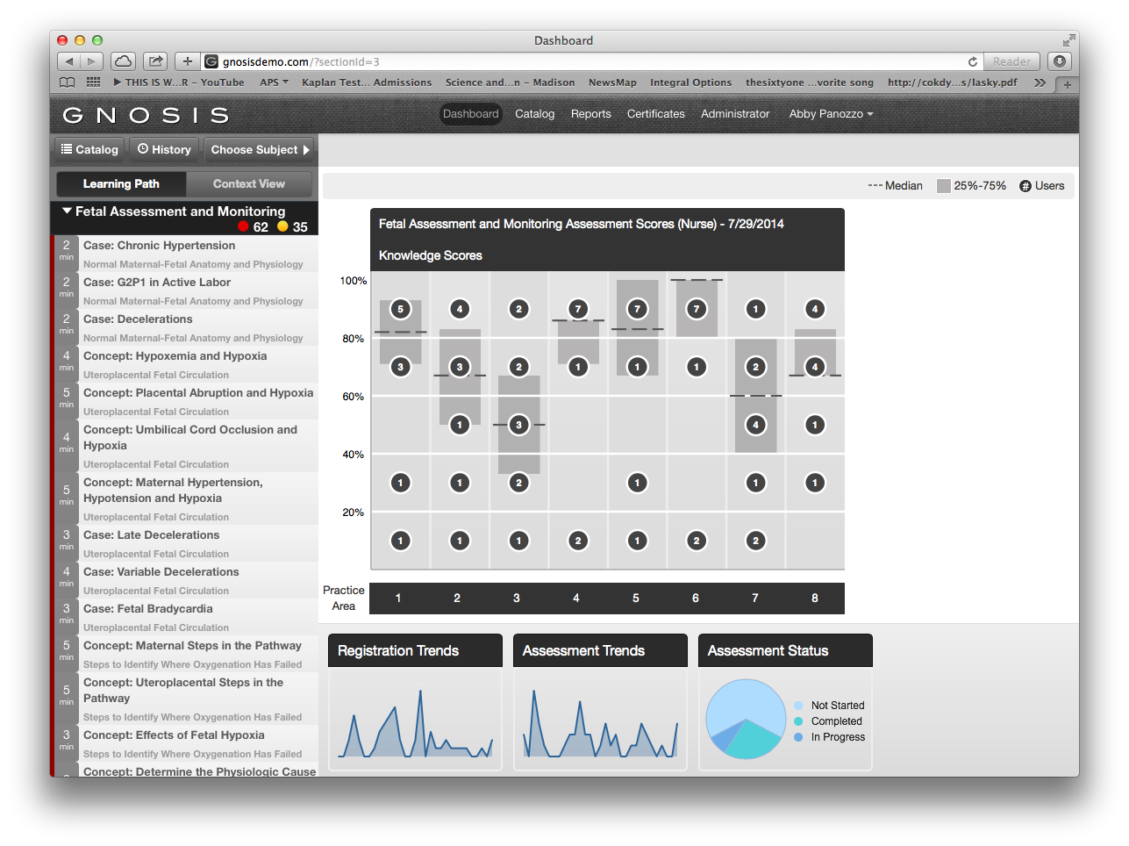
GNOSIS Learning Path
Congrats! You’ve completed your PPM.
Select Blue button to view your Learning Path
Directed to prioritized Learning Path
1
2
1

Slide 25
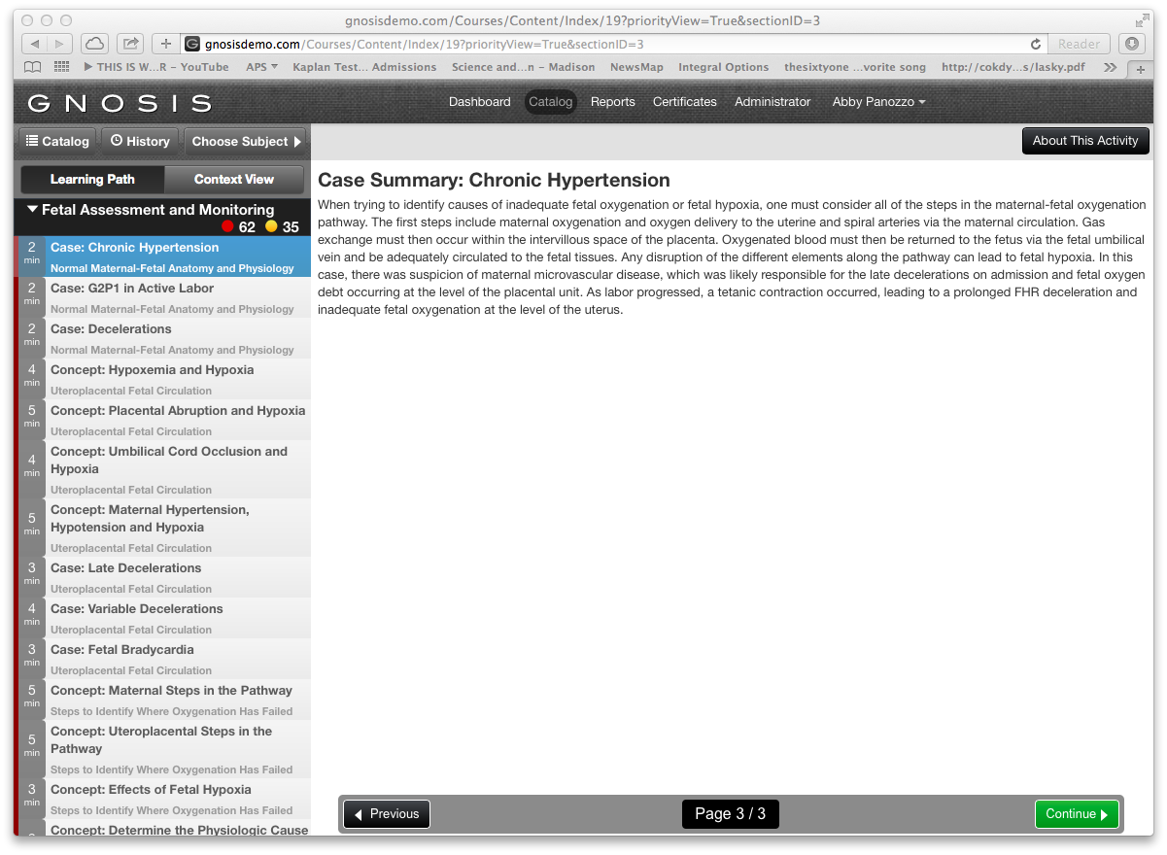
GNOSIS Learning Path
How to Review Learning Path Content Segments
Select Content Segment
Review Information
Select green continue button
1
2
3

Slide 26
PPM and Learning Path Average Completion Times¹
 | Fetal Assessment & Monitoring | Obstetrical Hemorrhage | Shoulder Dystocia
Nurses | 4.09 hours (PPM=84min, LP=164min) | 3.11 hours (PPM=44, LP=147) | 1.36 hours (PPM=27min, LP=69min)
Providers | 3.34 hours (PPM=75min, LP=139min) | 2.52 hours (PPM=37, LP=135) | 1.04 hours (PPM=22min, LP=42min)
Total Potential Credit Hours² | 8 hours | 4.25 hours | 1.75 hours
1. Source: GNOSIS user logs 1/1/2013-5/5/2014. 2. You do not earn credit for completing the PPM and total credit hours reflect completing all content: red, yellow and green content segments or the long format course.

Slide 27
GNOSIS CERTIFICATES

Slide 28
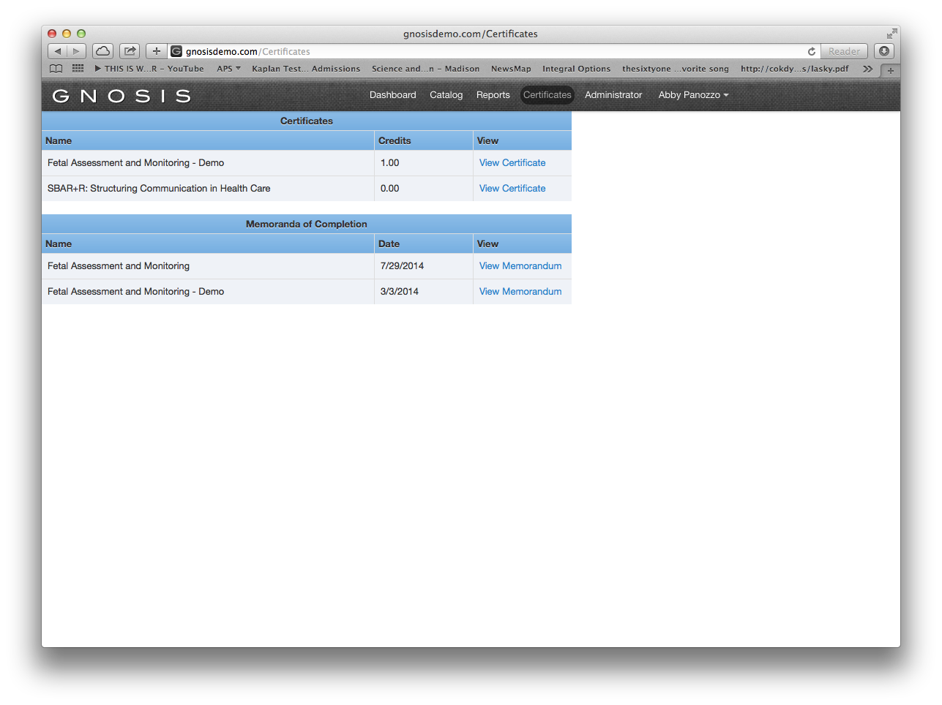
GNOSIS Certificates & Completion of Learning Path
GNOSIS Certificates is repository for two types of certificates: 1. certificates for a clinician’s accrued CME/CE contact hours and 2. memorandum of completions.
CME/CE certificates are accrued in 15 minute increments as a clinician completes a subject area’s Learning Path. Memorandums of Completions are granted once you complete a subject area’s PPM and corresponding Learning Path.
A clinician can submit accrued CME/CE credit for contact hours earned completing GNOSIS education
GNOSIS Learning Path completions live under the Memorandum of Completion
1
2

Slide 29
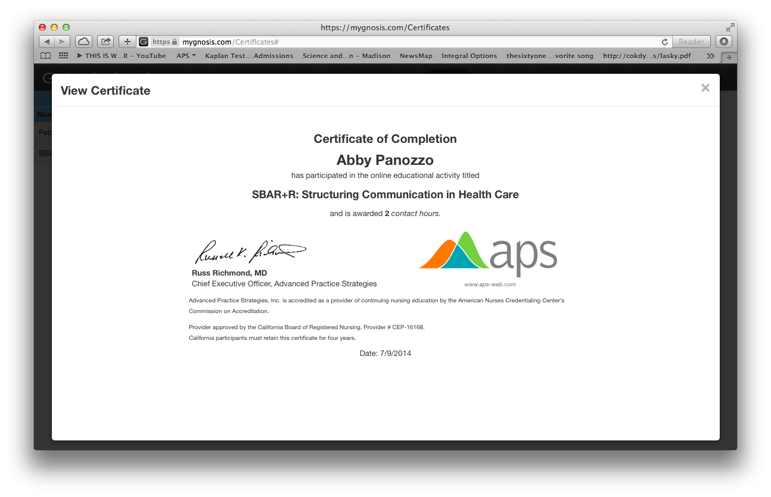
GNOSIS Certificates
8. Select ‘View Certificate’ to display the certificate to submit for educational content hours earned
9. Print or email for your records. We also recommend clinicians emailing memorandum of completions to their GNOSIS Peer Mentor.
8
9

Slide 30
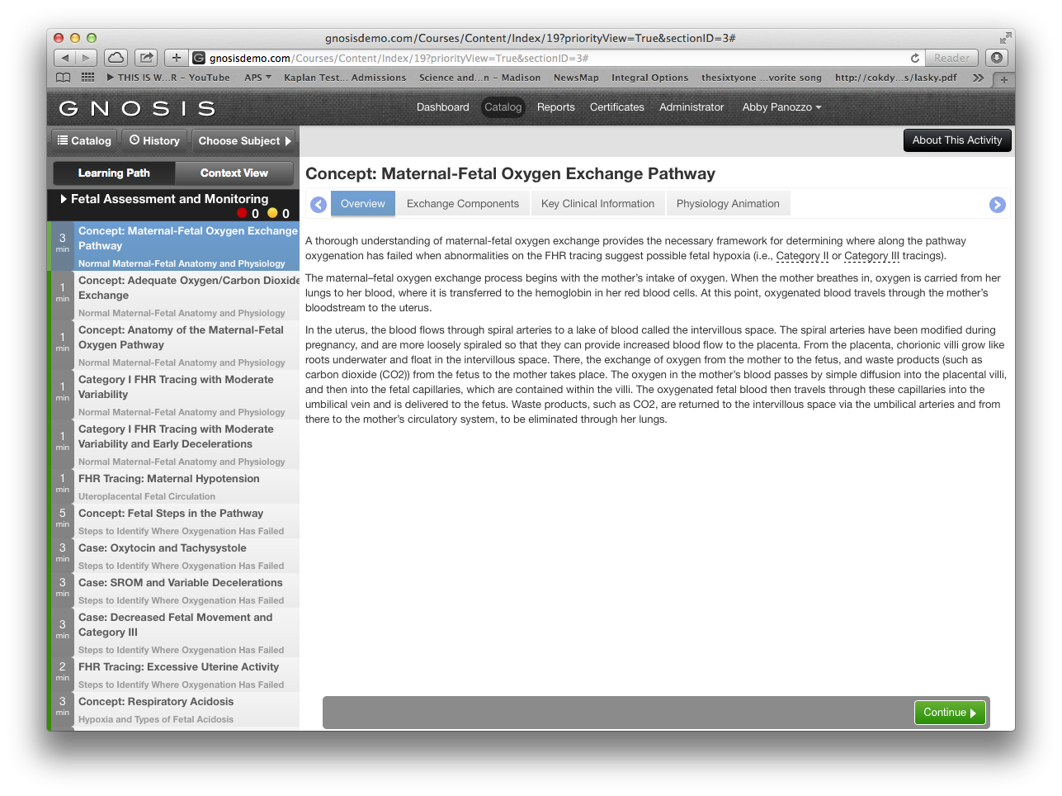
GNOSIS Memorandum of Completion of Learning Path
Summary of red and yellow content segments is zero
Remaining content are green and available to complete for more credit hours
Select “certificates”
Certificates generated for CME/CE credits earned
Memorandum of Completion generated for completing GNOSIS Learning Path
3
1
2
4
5

Slide 31
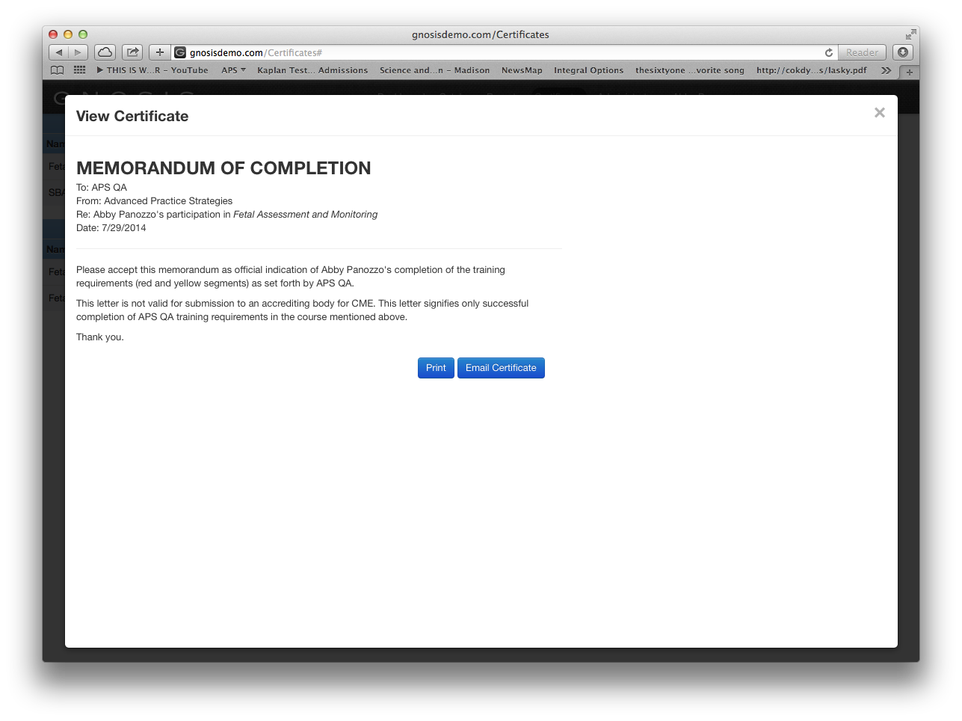
GNOSIS Memorandum of Completion of Learning Path
6. Select ‘View Memorandum’ to display memorandum of completion for Fetal Assessment & Monitoring Learning Path
7. Print or email for your records. We also recommend clinicians emailing memorandum of completions to their GNOSIS Peer Mentor.
6
7

Slide 32
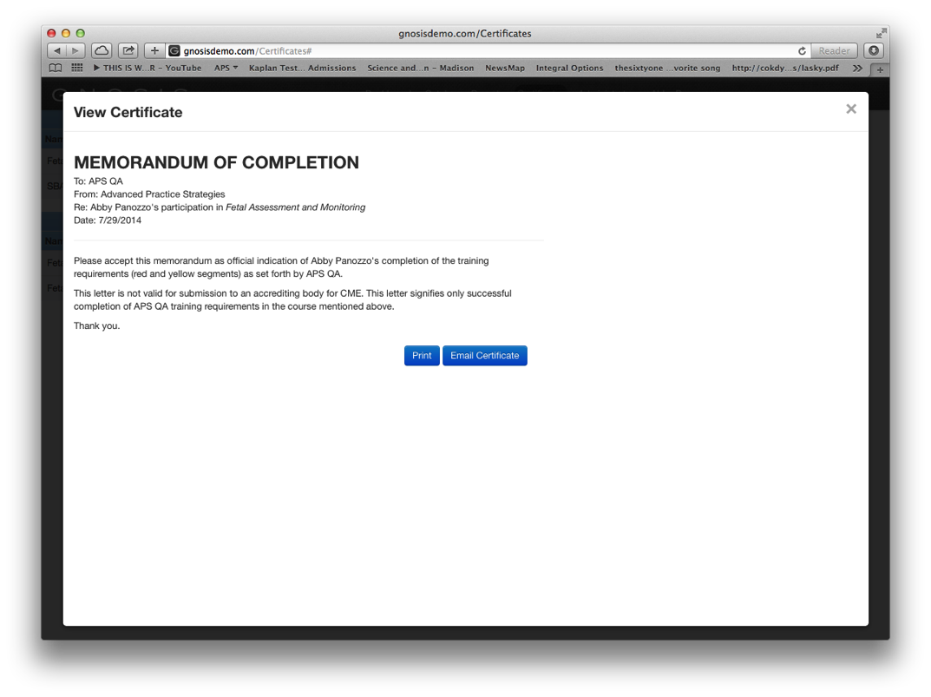
GNOSIS Certificates versus Memorandum of Completion
Below is a comparison of 1. GNOSIS contact hour certificates for CME/CE credits in contrast to the 2.GNOSIS Memorandum of Learning Path completions.
1
2

Slide 33
Accruing CME/CE Credits
A clinician earns CME/CE credits by completing GNOSIS coursework through the Learning Path or by completing a traditional long format course. CME/CE credit is not granted for subject area’s PPM. If completing GNOSIS education through a Learning Path , each practitioner will accrue a different amount of credit if completing only the red & yellow content segments.
Subject Area | Total Potential Credit Hours to Earn ¹
Fetal Assessment & Monitoring | 8 hours
Obstetrical Hemorrhage | 4.25 hours
Shoulder Dystocia | 1.75 hours
To earn the total amount of CME/CE credit hours available you can complete the red, yellow and green content segments in your Learning Path
1. You do not earn credit for completing the PPM.

Slide 34
Example: Demonstrating accruing CME/CE Credits
A sample learning path is displayed. Summarizing the time for the content segments provides 28 minutes towards continuing medical education.
3 mins
3 mins
4 mins
5 mins
5 mins
5 mins
1 min
2 mins
+
28 minutes and
0.25 accrued CME/CE credits
(30 minutes = 0.5 CME/CE credits)
Notes:
The PPM establishes your Learning Path which is unique to each individual practitioner’s proficiencies. Each practitioner is provided color-coded & prioritized content for self-directed education and review.
Red represents content to focus on improving immediately- high priority content
Yellow represents content to review and refresh- medium priority content
Green represents content where the PPM determined you were clinically proficient.
Complete each of the red and yellow content segments in order to receive your memo of completion of your Learning Path.
What determines how content components get color-coded?
The learning path is developed based on a user’s PPM score and the clinical significance of the content. The process consists of the following steps:
Each piece of content is weighted, based it clinical significance.
PPM questions are mapped to each area of content.
Learning paths are tested using canonical users to ensure its accuracy
and reliability.

Slide 35
GNOSIS REPORTING FOR CLINICAL USERS My Scores

Slide 36
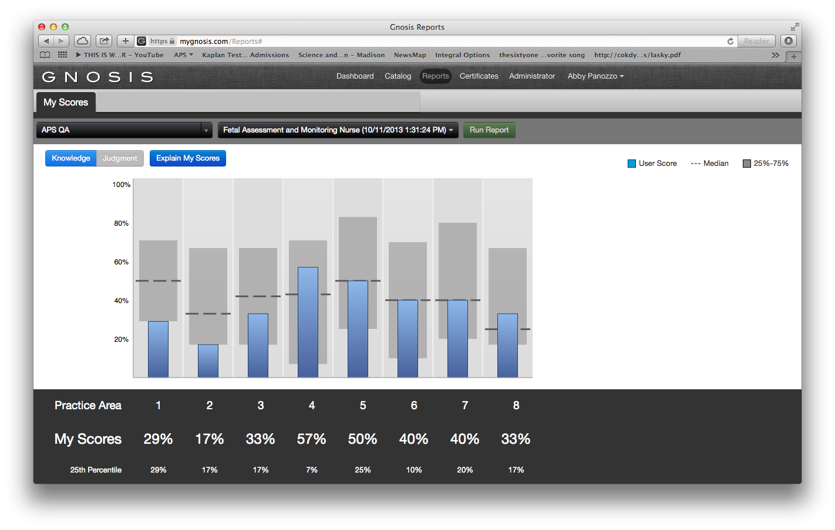
GNOSIS Reporting for Clinical Users Knowledge Report
Answers to PPM questions are used to create two reports: a Knowledge report and a Judgment report.
The knowledge report shows how a user’s performance compares to that of his/her peers who took the PPM.
1. A user’s peer group comprises the set of users that are members of the group selected for the report.
2. The grey band represents the 25th to 75th percentile.
1
2

Slide 37
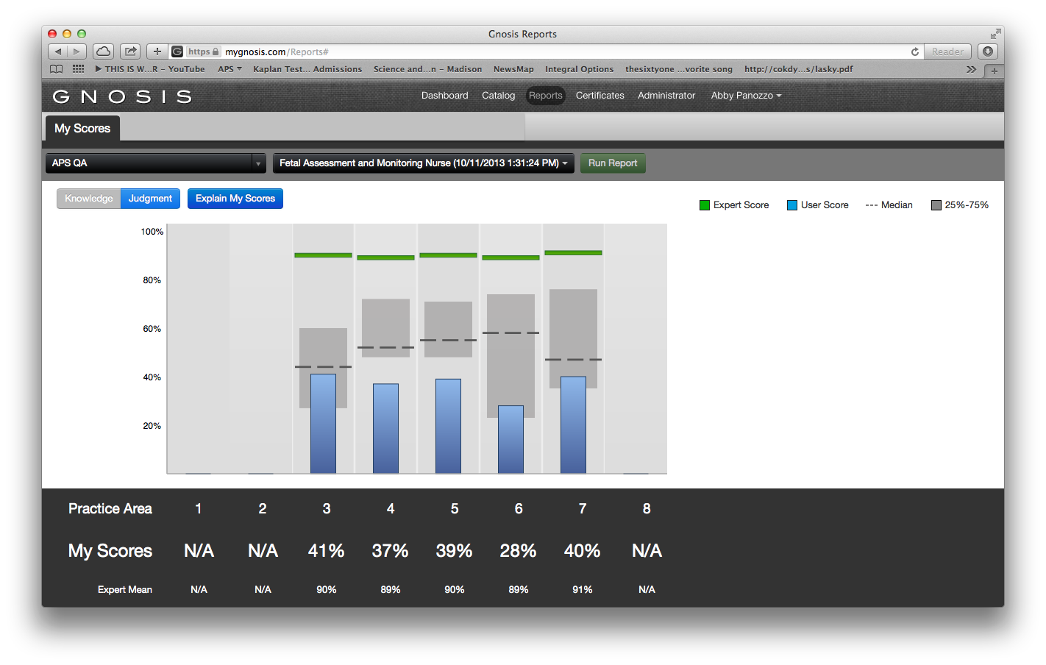
GNOSIS Reporting for Clinical Users Judgment Report
The Judgment report shows how a user’s performance compares to that of his/her peers, as well as the expert panel.
The grey band represents the 25th to 75th percentile.
The green bar represents the average score of the experts who took the assessment in each practice area.
There are two expert panels. If taking the PPM as a physician, performance is measured against a physician panel. If taking it as a nurse, a nurse panel is used.
2
1

Slide 38
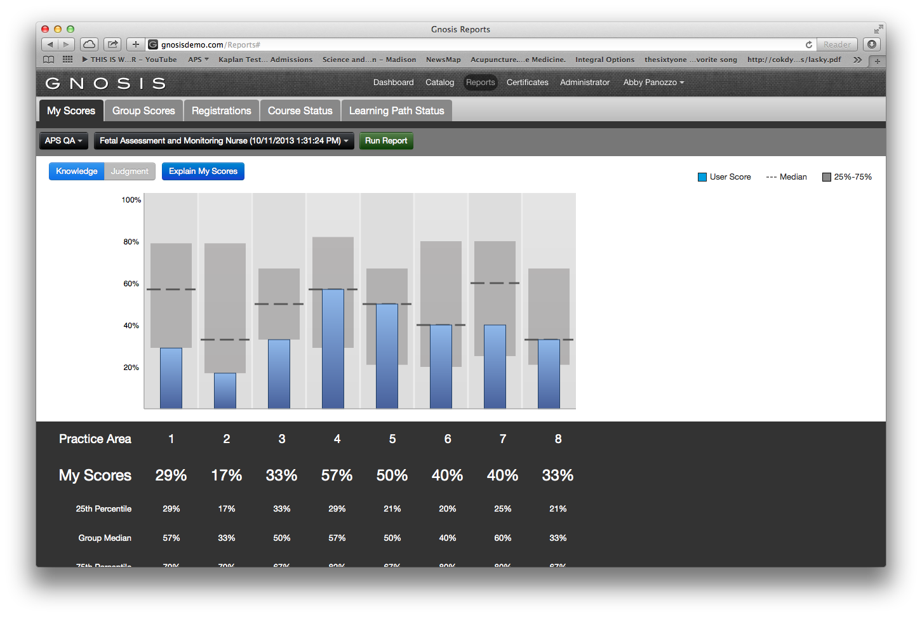
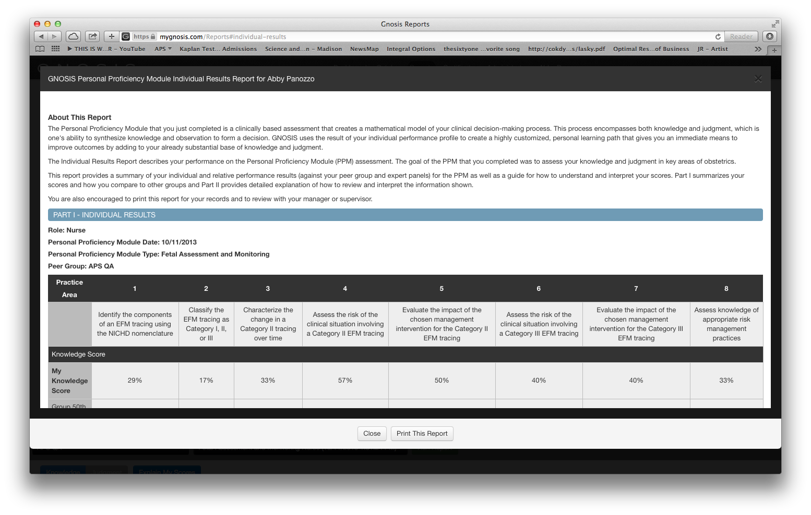
GNOSIS Reporting for Clinical Users Explain My Score
Each Personal Proficiency Module report an “Explain My scores” feature to interpret your scores.
Select “Explain My Score”
Review content
1
2

Slide 39
GNOSIS CATALOG

Slide 40
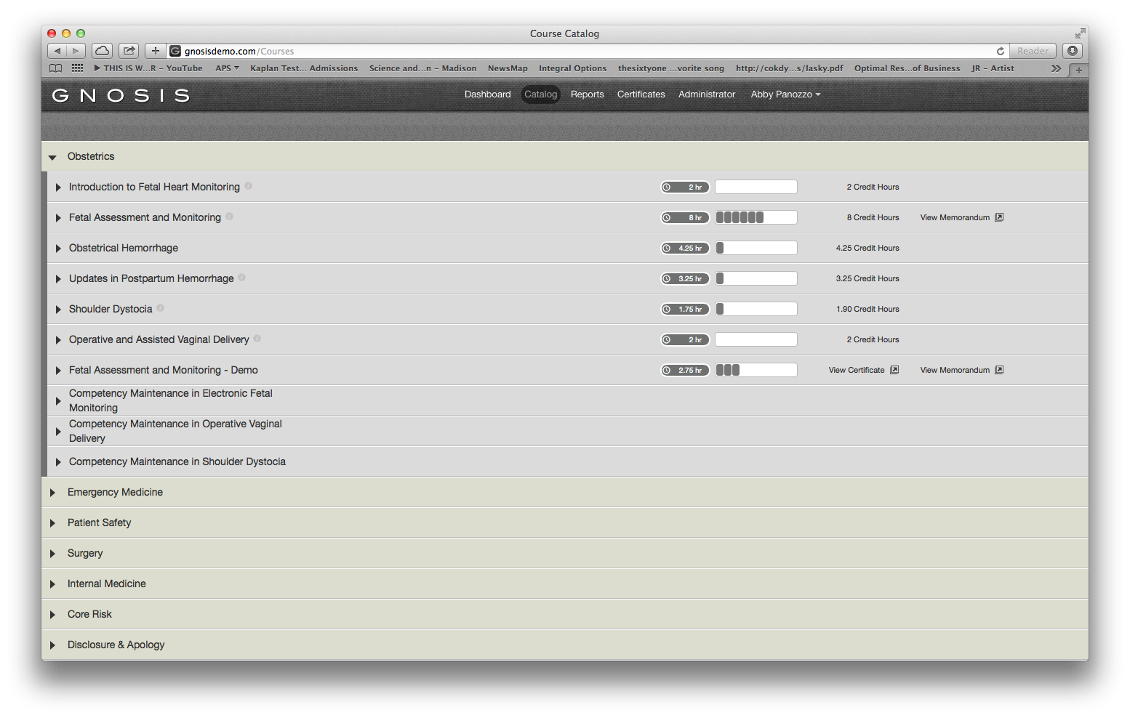
GNOSIS Catalog
GNOSIS Catalog shows the totality of assigned content, organized much like a table of contents. Users see the content which they are currently working and will see how they’re progressing toward completion. Credit hours and earned certificates will also be visible when applicable.
1
All GNOSIS courses assigned
1
2
2
CME/CE progress accrued as you complete GNOSIS content
3
3
View GNOSIS certificates for the
CME/CE credits earned

Slide 41
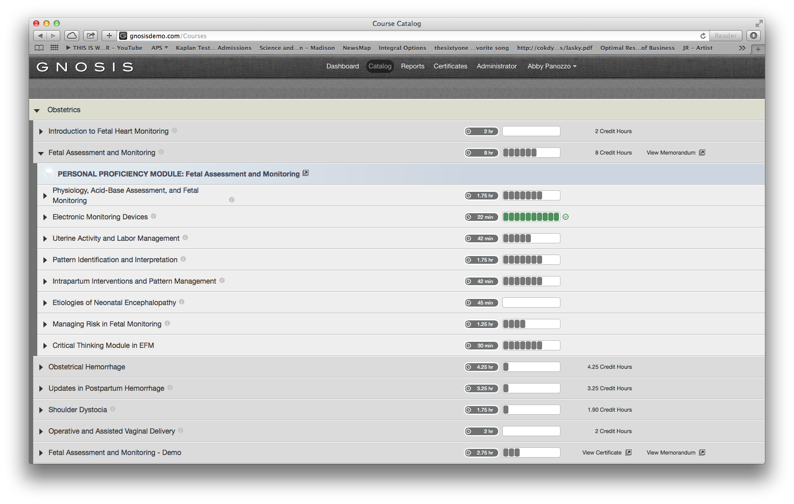
GNOSIS Catalog: Courses beginning with a PPM
Courses such as Fetal Assessment & Monitoring can begin with the PPM from the Catalog
Select Fetal Assessment & Monitoring
Begin the PPM by selecting “PERSONAL PROFICIENCY MODULE: Fetal Assessment & Monitoring”
1
2

Slide 42
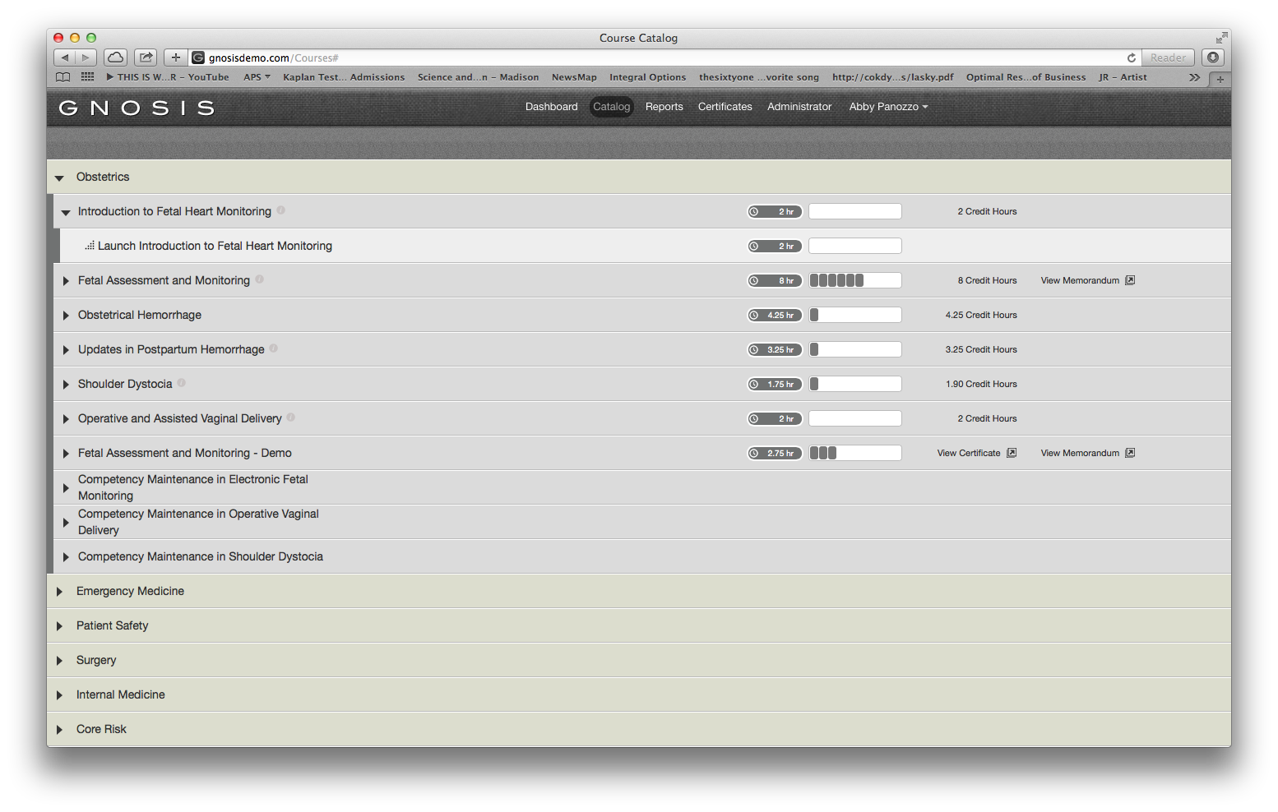
GNOSIS Catalog: Courses without a PPM
Select the name of the course, such as Introduction to Fetal Heart Monitoring. Courses without a PPM begin immediately with content.
Select “Launch: Introduction to Fetal Heart Monitoring” to begin the course.
1
2

Slide 43
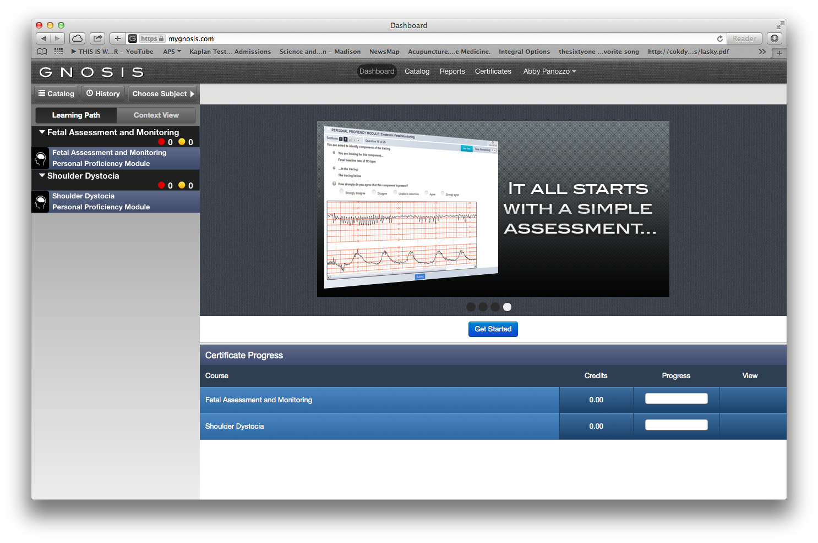
GNOSIS Dashboard of CME/CE Credits
Each time you log into GNOSIS your CME/CE progress is summarized at the bottom. Both courses with a PPM and without a PPM will appear. This indicates progress through the course, not progress through the Learning Path.
Notes:
As the individual user completes their Learning Path blocks, the Certificate Progress indicator saves credit towards the certificate in 15 minute increments.

Slide 44
GNOSIS ADMINISTRATIVE EXPERIENCE ANALYZING PRACTITIONER PROFICIENCY

Slide 45
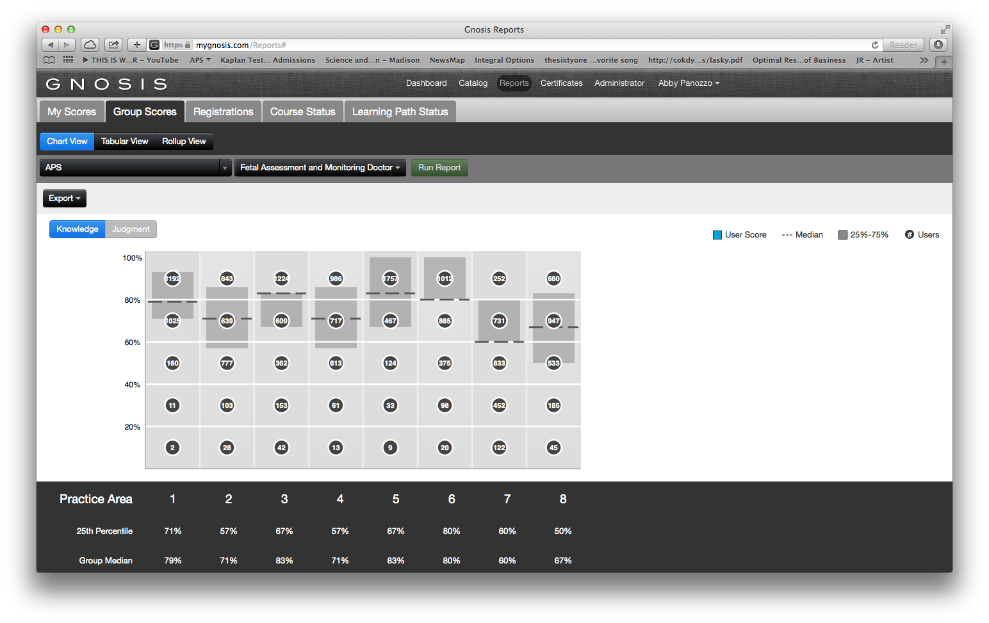
Analyze Practitioner's Subject Area Proficiency
GNOSIS provides valuable information about a population enabling Peer Mentors a direct way to continuously improve performance, achieve key goals and report on both the needs and results of the clinical teams.
Based on report results a Peer Mentor of a group may target specific initiatives or provide additional training for certain practice areas to move the entire staff to achieve excellence.

Slide 46
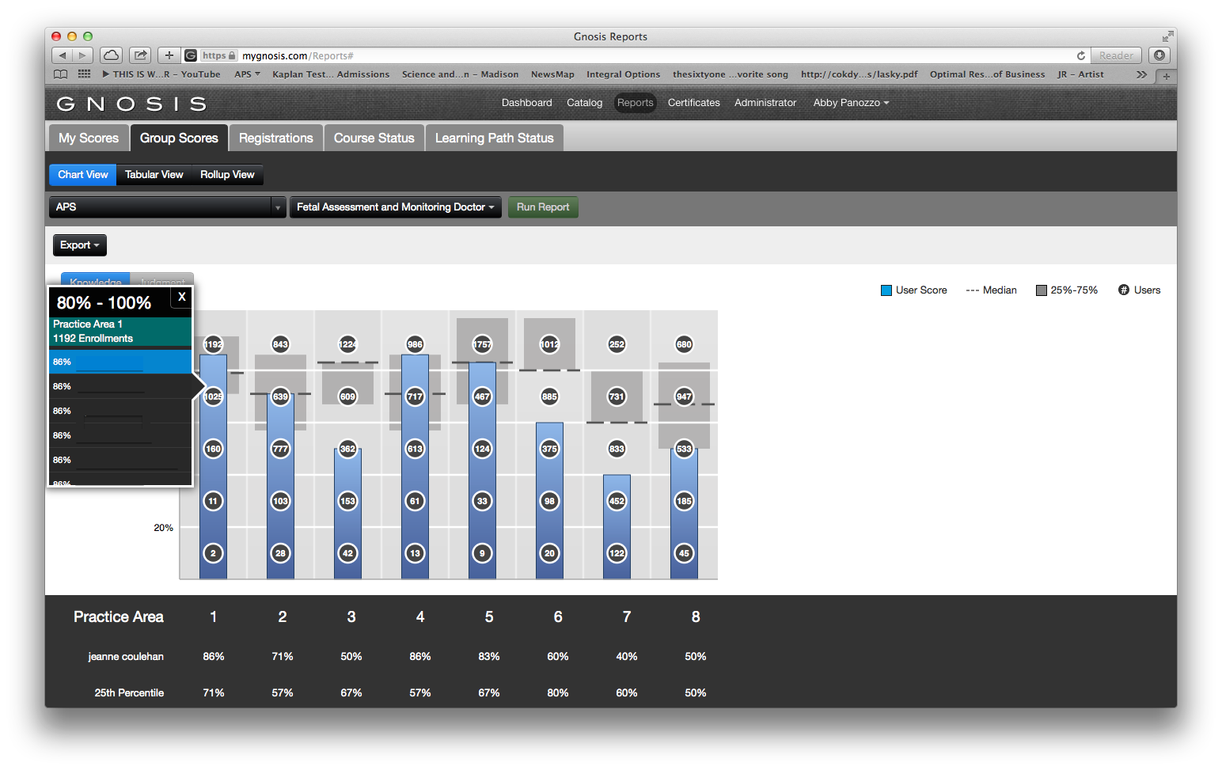
Analyze Practitioner's Subject Area Proficiency Knowledge Questions
Peer Mentors can view the PPM scores of an entire group. Results are organized by practice area and PPM question type.
1.The dark band highlights the 25th to 75th percentile distribution of results.
2.Each circle represents the number of users whose score for a Practice Area fell within a specific range (e.g. 0-20%, 20-40%, etc.).
Clicking on a circle brings up a list of corresponding users to drill down and see all of their scores.
1
2

Slide 47
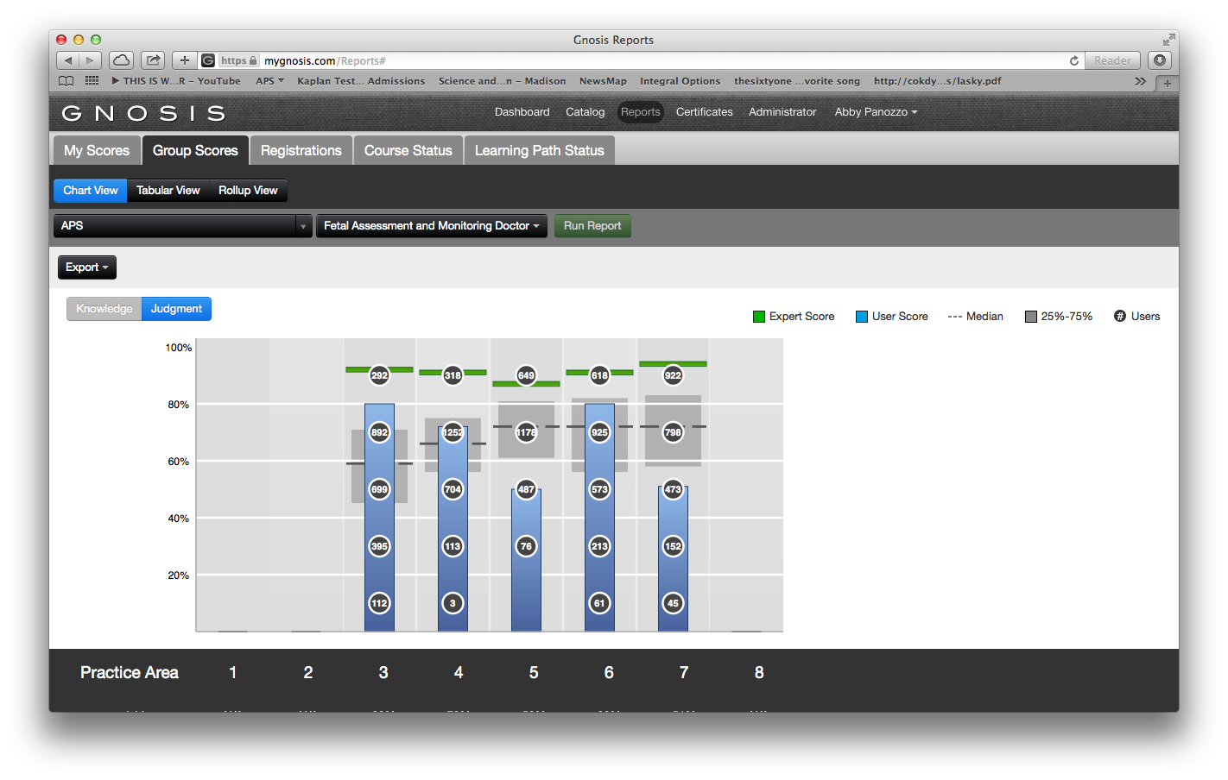
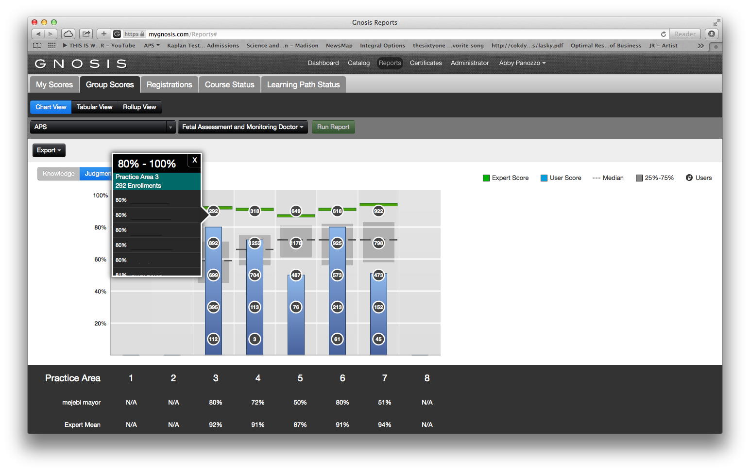
Analyze Practitioner's Subject Area Proficiency Judgment Questions
The Judgment Report is presented in a similar fashion to the Knowledge Report. Results are organized by practice area.
3.Select Judgment to view scores in practice areas with judgment questions
4. The Judgment report also displays a green line which represents the expert panel.
3
4

Slide 48
GNOSIS ADMINISTRATIVE EXPERIENCE MONITORING GNOSIS ENGAGEMENT

Slide 49
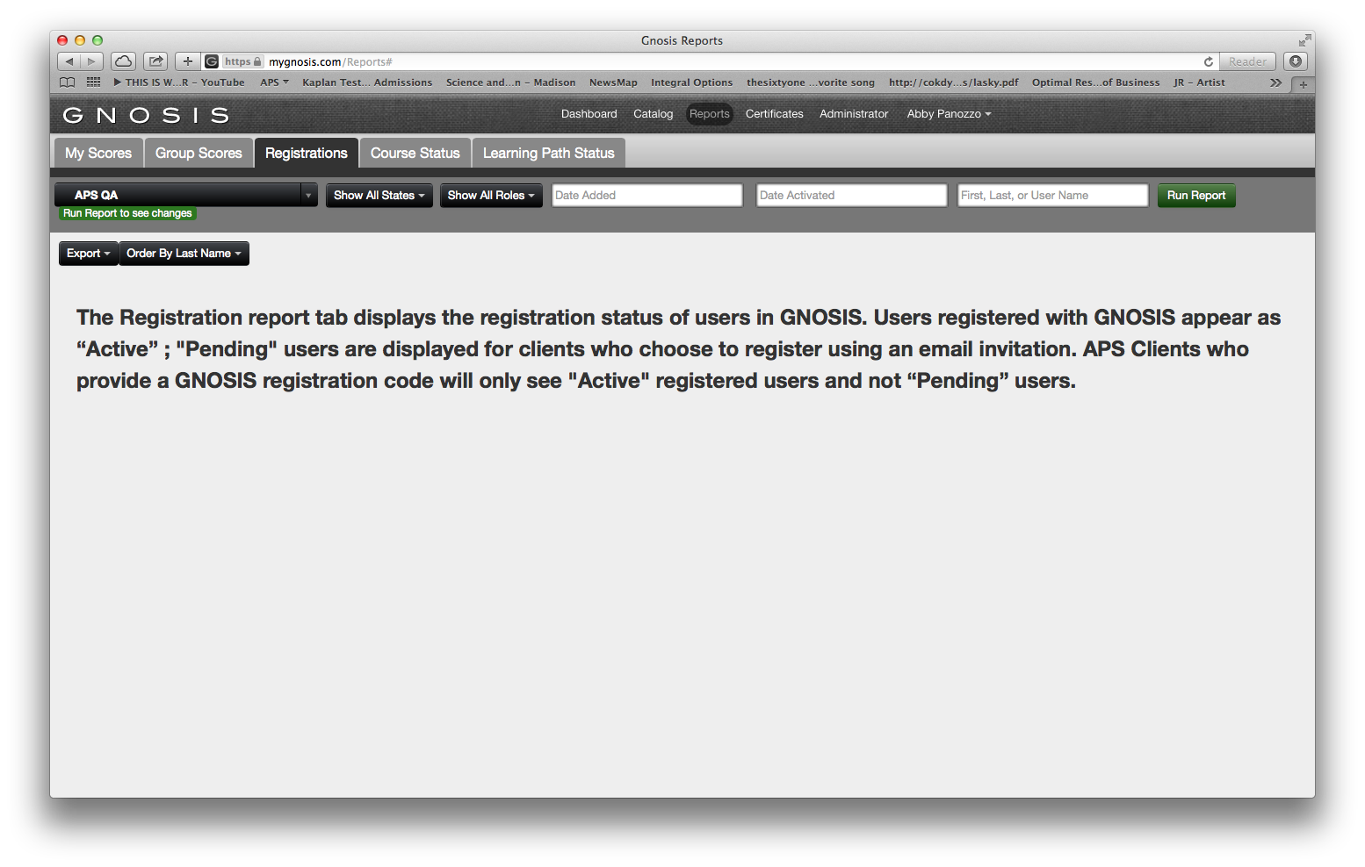
Monitoring GNOSIS Engagement Registrations
The Registration report tab displays the registration status of users in GNOSIS. Users registered with GNOSIS appear as “active”, pending users are displayed for clients who choose to register using an email invitation. APS Clients who provide a GNOSIS registration code will only see active registered users and not “pending” users.

Slide 50
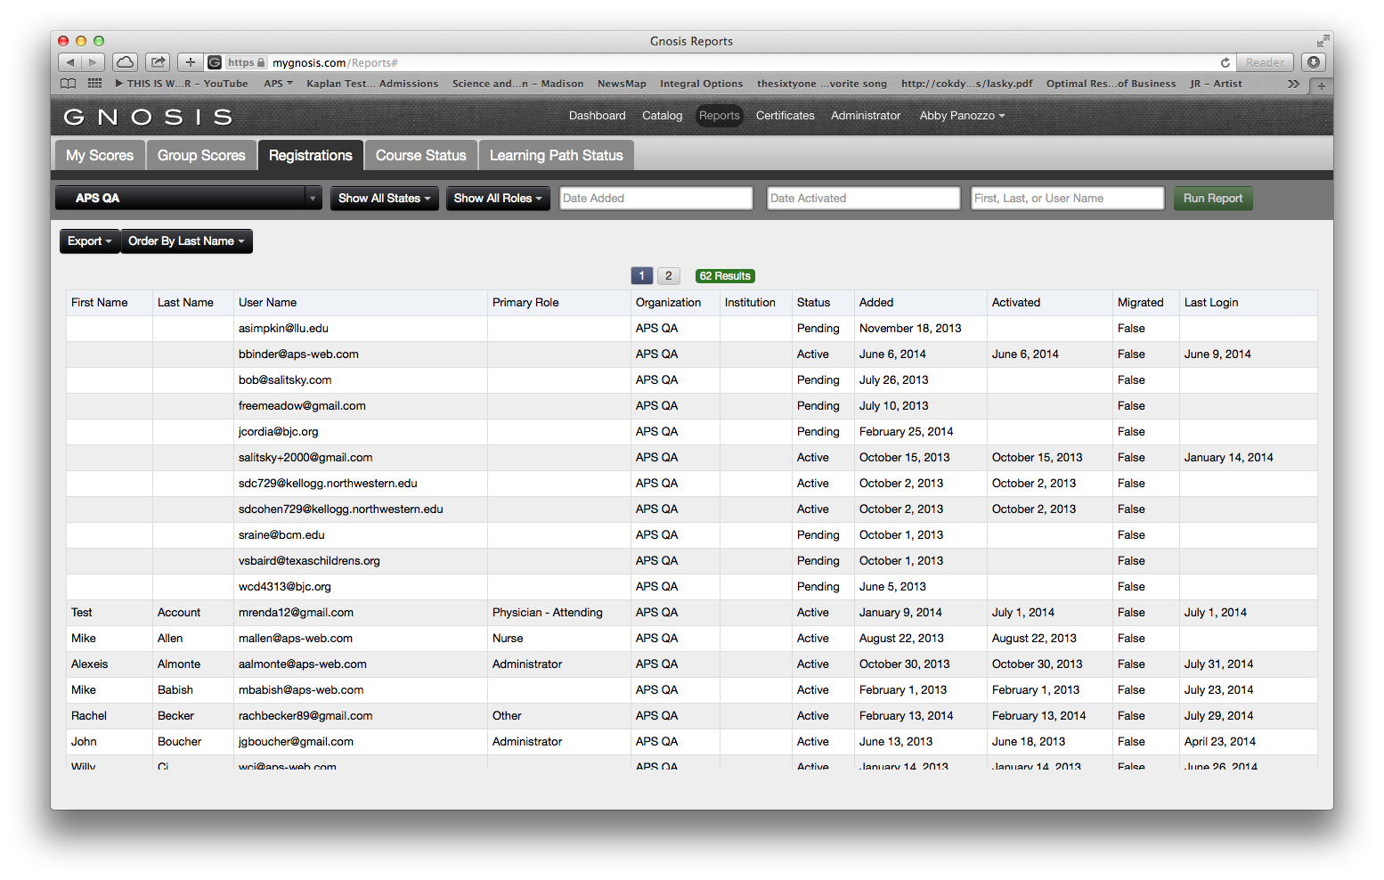
Monitoring GNOSIS Engagement Registrations
Select Reports
Select Registrations
Select parameters to run the report
Select green Run Report
Export report to CSV to view in Microsoft Excel
2
1
3
4
5

Slide 51
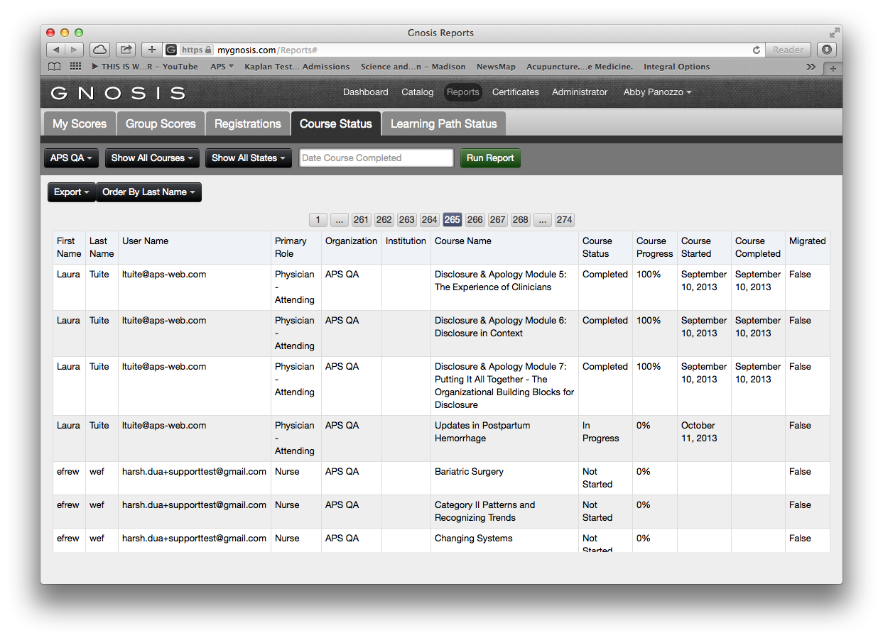
Monitoring GNOSIS Engagement Course Status
The Course Status tab displays a report for all GNOSIS courses purchased by the client. This includes courses with a PPM and without a PPM. A course is labeled as “complete” in Course Status if the user accesses a course with or without a PPM and clicks through the entire course, or if a user completes a course with a PPM by completing all red, yellow, and green content segments.

Slide 52
Monitoring GNOSIS Engagement Course Status
Select Reports
Select Course Status
Select parameters to run the report
Select green Run Report
Export report to CSV to view in Microsoft Excel
2
1
3
4
5

Slide 53
Monitoring GNOSIS Engagement Course Status
You can view
Course status
Course progress
Date of course started
Status of course completion
Completed equates to a user completing all content available for this course.

Slide 54
Monitoring GNOSIS Engagement Course Status
True indicates a course was completed in APS legacy platform, CourseServer
False indicates data was completed in GNOSIS

Slide 55
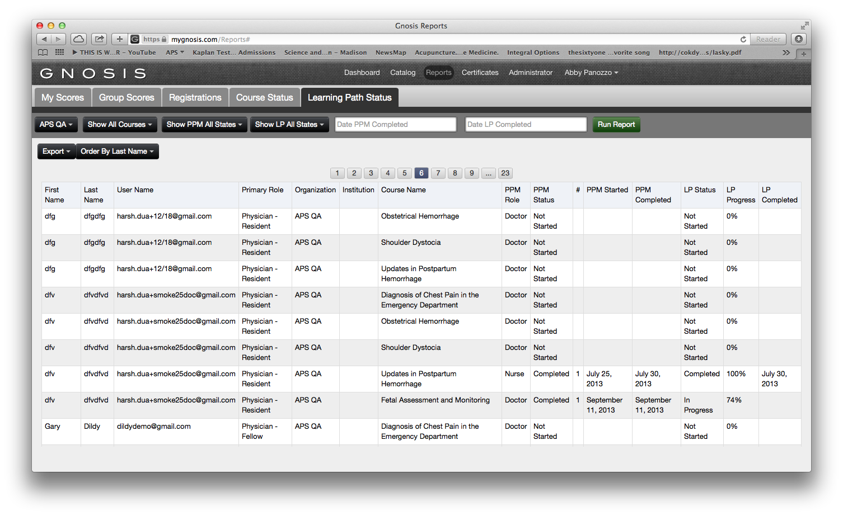
Monitoring GNOSIS Engagement Learning Path Status
The Learning Path Status tab displays a report for all GNOSIS courses with a PPM. A course is labeled “complete” if the user completes the PPM and the client requirements for completion for the corresponding Learning Paths.

Slide 56
Monitoring GNOSIS Engagement Learning Path Status
Select Reports
Select Learning Path Status
Select parameters to run the report
Select green Run Report
Export report to CSV to view in Microsoft Excel
2
1
3
4
5

Slide 57
Monitoring GNOSIS Engagement Learning Path
Monitor course progress using the drop down menus
Courses
PPM States
LP States
Date PPM Completed
Date LP Completed

Slide 58
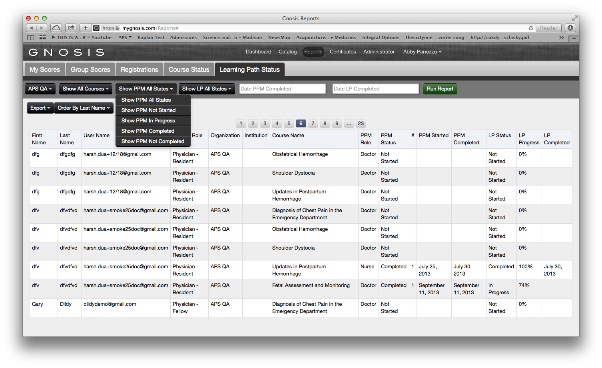
Monitoring GNOSIS Engagement Learning Path
PPM States
All States
Not Started
In Progress
Completed
Not Completed

Slide 59
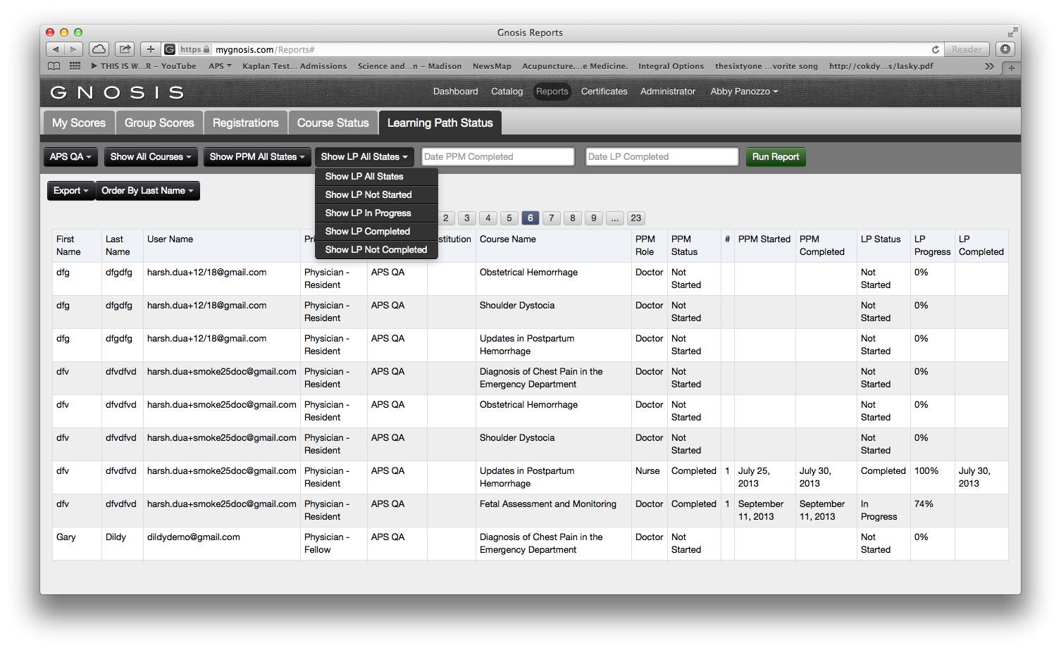
Monitoring GNOSIS Engagement Learning Path
LP States
All States
Not Started
In Progress
Completed
Not Completed

Slide 60
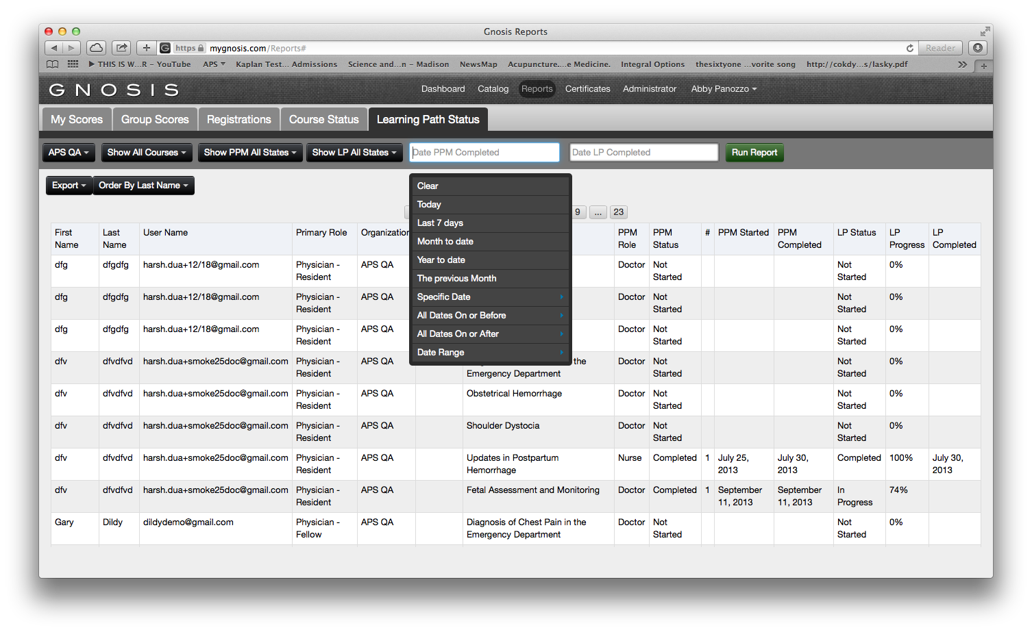
Monitoring GNOSIS Engagement Learning Path
Clear
Today
Last 7 Days
Month to Date
Year to Date
The Previous Month
Specific Date
All Dates On or Before
All Dates on or After
Date Range

Slide 61
Monitoring GNOSIS Engagement Learning Path
Indicates which number PPM. For example, it there is a 1 in this column it is the user’s first PPM.

Slide 62
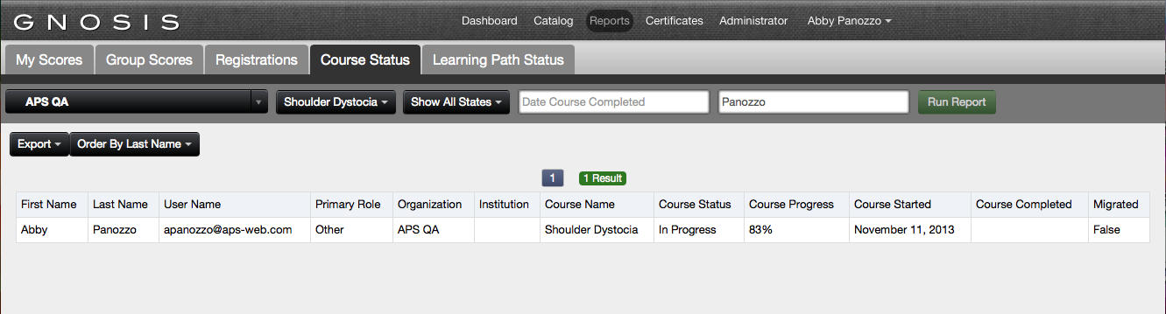
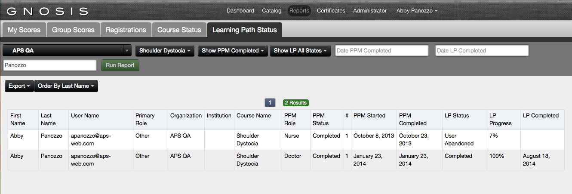
Comparing Course Status v. Learning Path Status
Depending on the GNOSIS report that is run a GNOSIS courses that begins with a Personal Proficiency Module will appear differently on the Course Status tab compared to the Learning Path Status tab. Since the PPM is designed to assist clinicians use their time for efficiently and concentrate on prioritize education, most relevant to them, an individual clinician will not be completing the entire course.
EXAMPLE
Shoulder Dystocia is a course that can begin with a PPM. If a clinician completes the PPM and the content segments in the Learning Path, then…
1.Course Status will reflect the percentage of entire Shoulder Dystocia completed
2. Learning Path Status will reflect 100% complete
1
2

Slide 63
ENDING YOUR GNOSIS SESSION

Slide 64
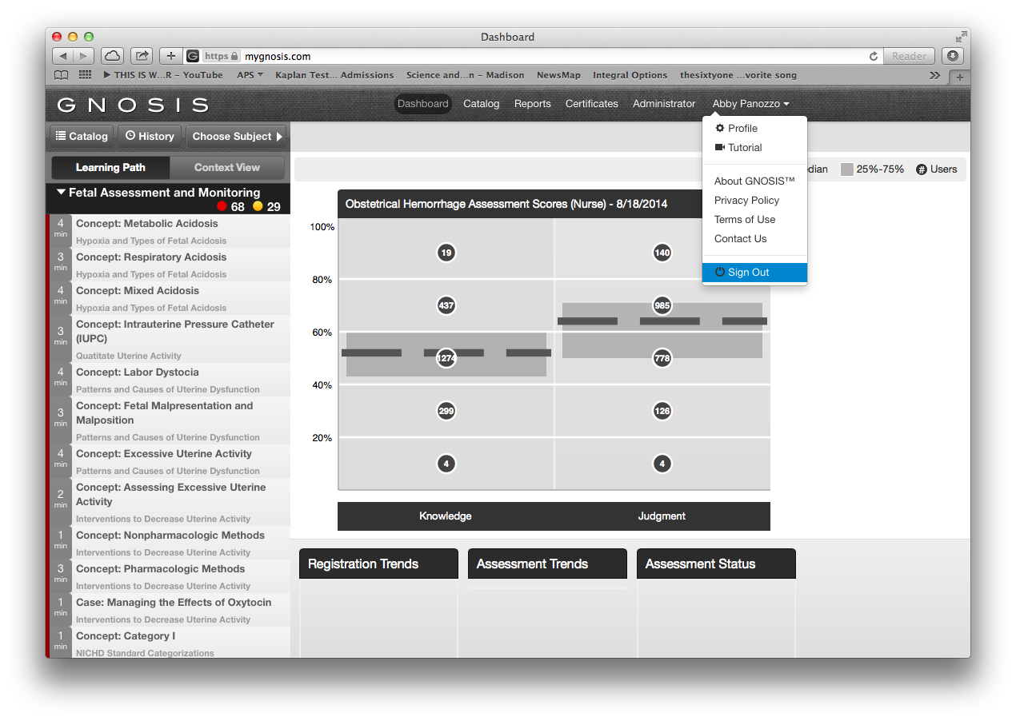
Logging out of GNOSIS
GNOSIS saves the progress of your Learning Path. For your security be sure to log out after each session.
1.Select your name
2.Select Sign Out
1
2
Notes:
As the individual user completes their Learning Path blocks, the Certificate Progress indicator saves credit towards the certificate in 15 minute increments.

Slide 65
CUSTOMER SUPPORT & ADDITIONAL FEATURES

Slide 66
APS CUSTOMER SUPPORT
Phone
24 hours per day, 7 days per week p. 877-277-4500
Email
Monday-Friday 8 AM – 5PM EST
e. support@aps-web.com

Slide 67
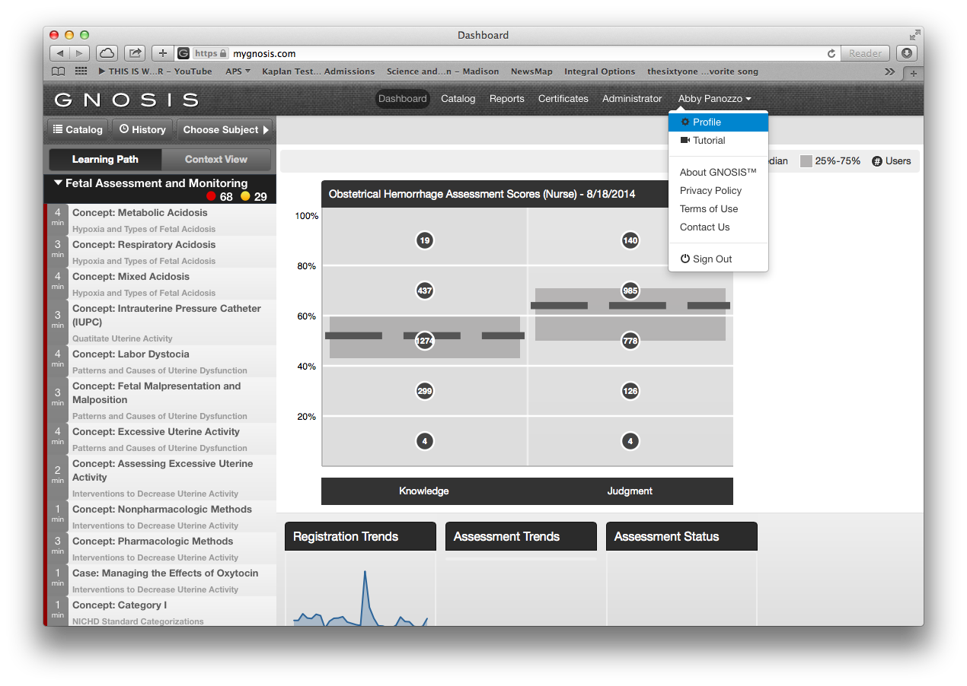
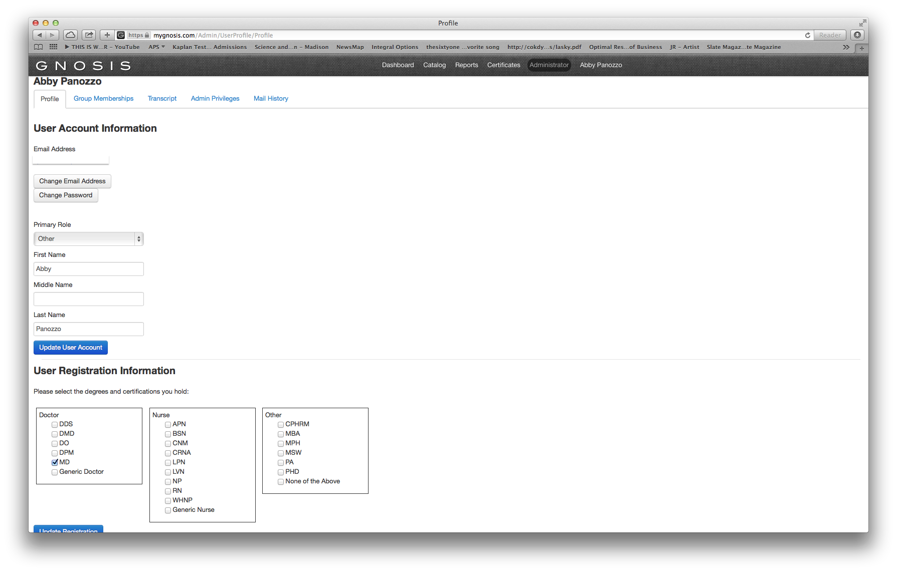
GNOSIS Profile
GNOSIS Profile includes adjustable settings for primary role, degree information, email, and password changes. Apply changes by selecting the blue update user account or update registration
1.Select your name
2.Select Profile
3.Update Email or Password
4.Update registration information
1
2
3
4
Notes:
As the individual user completes their Learning Path blocks, the Certificate Progress indicator saves credit towards the certificate in 15 minute increments.

Slide 68
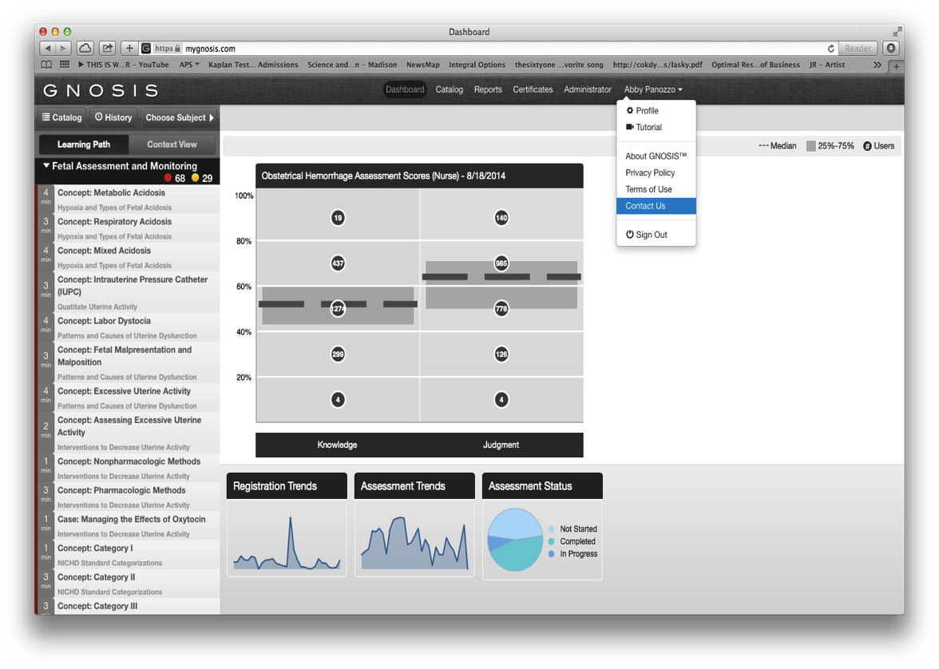
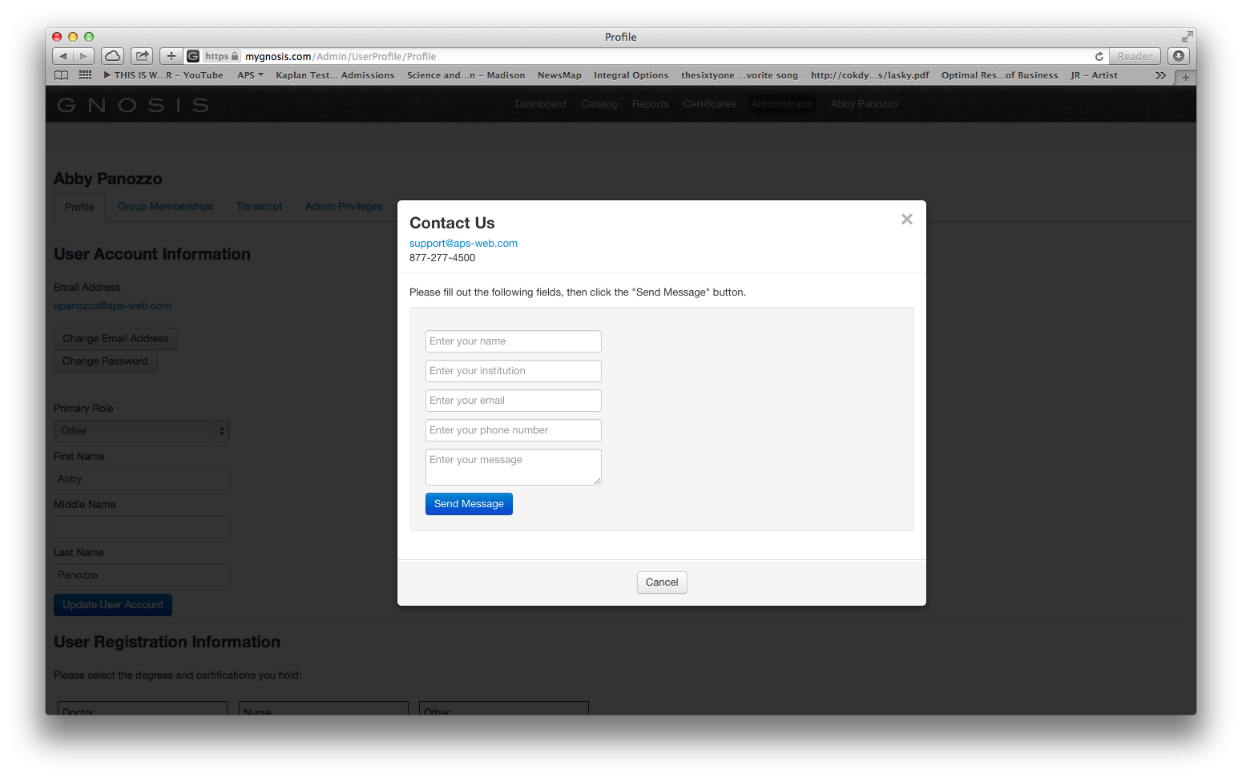
Contact Us
GNOSIS allows each user to contact APS regarding our products and content
1.Select your name
2.Select Contact Us
3.Compose a message to our team
4.Select Send Message
1
2
3
4
Notes:
As the individual user completes their Learning Path blocks, the Certificate Progress indicator saves credit towards the certificate in 15 minute increments.

Slide 69
THANK YOU

